Slide 1
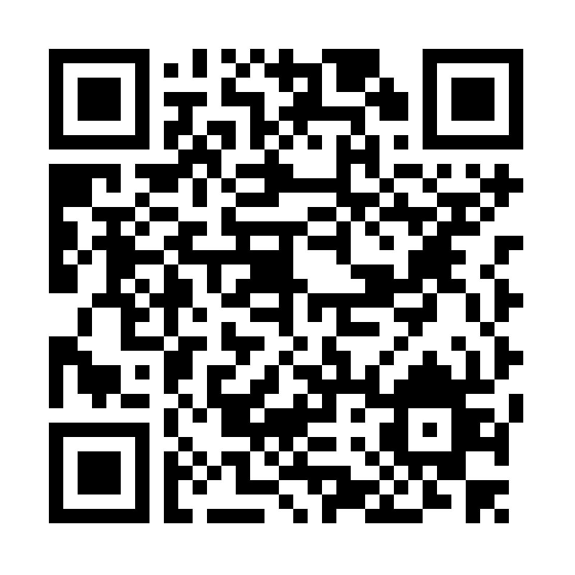
Building a Learning Hour Portfolio

Slide 2
Resources:
https://github.com/isidore/Talks/blob/master/LearningHourPortfolio.md

Slide 3
Rules For Learning Hour
Guidelines
Open to everyone in the company
Valuable to people outside of the company
1 Hour every day
Same hour each day
Same Room each day (if possible)
Sessions can run multiple days

Slide 4
What would you Teach?

Slide 5
Awareness
Proficiency
Fluency

Slide 6
Awareness

Slide 7
Awareness
The sampler sessions

Slide 8
Introducing…
Skills
TDD
Safeguarding
Exploratory Test Heuristics
Exceptions Messages
Tools
Git
Java, Typescript Python
Java8
GraphQl
micronaut
Ideas
Growth/Fixed Mindset
Vectorized Words
Theory Base Tests
Language of Emotions

Slide 9


Failed

Slide 10
Failed

Slide 11
Failed

Slide 12
Types
Talks / Videos
Activities / Games
Discussions

Slide 13

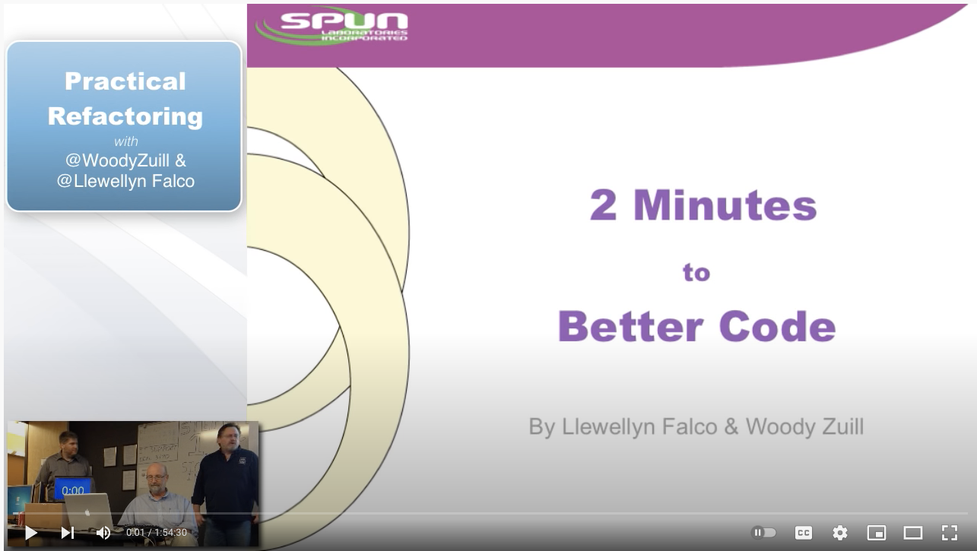
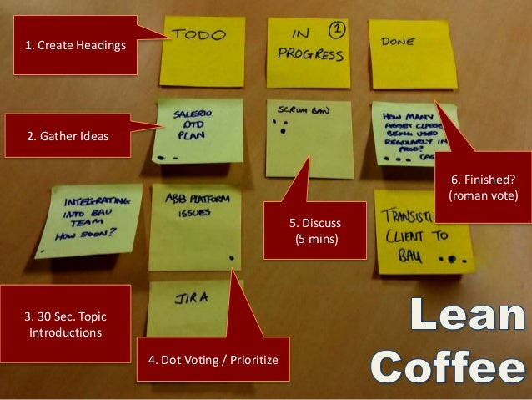

Movie Night
+
Video (45 mins)
Lean Coffee (15 mins)

Slide 14
Proficiency
“I can DO this”

Slide 15
Hands On
Skills
TDD
Safeguarding
Exploratory Test Heuristics
Exceptions Messages
Tools
Git
Java, Typescript Python
Java8
GraphQl
micronaut

Slide 16
Failed

Slide 17
Failed

Slide 18
Types
Exercises
Katas
Koans
Mob / Group

Slide 19
Fluency
“I can do this in my sleep”

Slide 20
Types
Exercises / Repetitions
Pairs / Solo
Core / Fundamental Skills

Slide 21
Micro-skills Week
 | Monday | Tuesday | Wednesday
Visual Thinking Strategies | 15 | 15 | 15
Typing | 15 | 15 | 15
Keyboard Shortcuts | 15 | 15 | 15
Meditation | 15 | 15 | 15

Slide 22
What would you like to teach your teams?
Let’s get to brain storming…

Slide 23
What would you like to teach your teams?

Slide 24
Give Yourself Space To Explore
Normalize Learning At Work

Slide 25
Resources:
https://github.com/isidore/Talks/blob/master/LearningHourPortfolio.md

Slide 26
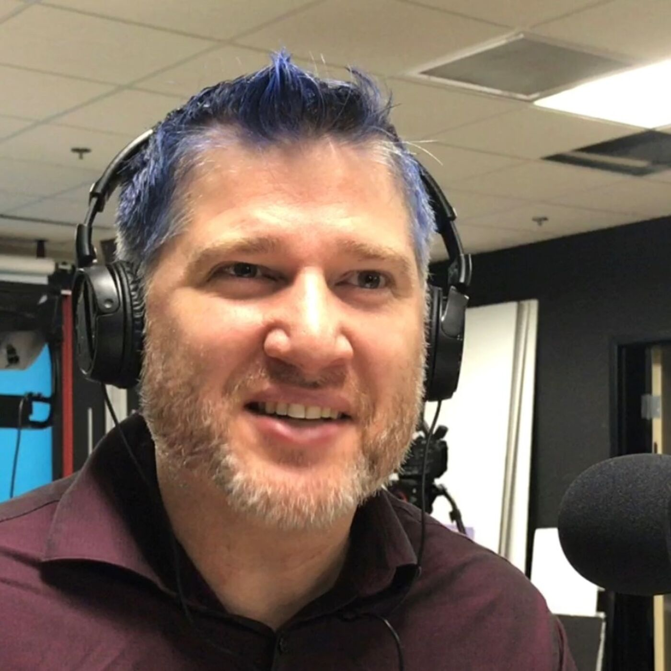
Thank You!
*Slides by Slide Carnival
I am Llewellyn Falco
Please connect via LinkedIn & Twitter

Slide 27
Exploring your Portfolio Space
Tools
Skills
Skills
Awareness
Fluency
Learning Hour
Ideas
Proficiency
Tools
Skills

Slide 28









Extra graphics
Change the color of gray shapes with the “Recolor image” functionality. Draw your own feet, hands and mouths to create unique characters and have fun!

Slide 29
SlidesCarnival icons are editable shapes. This means that you can:
Resize them without losing quality.
Change fill color and opacity.
Change line color, width and style.
Isn’t that nice? :) Examples:
Find more icons at slidescarnival.com/extra-free-resources-icons-and-maps

